Slide 1




Data Exploration
By Cameron and Jordan

Slide 2
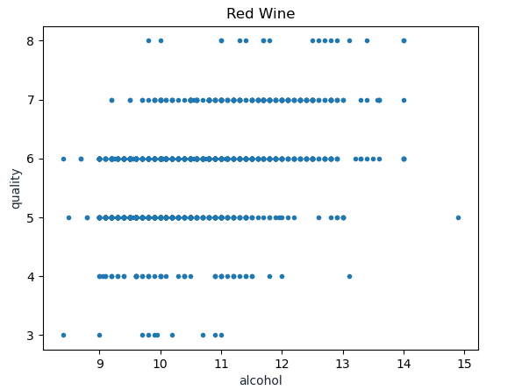
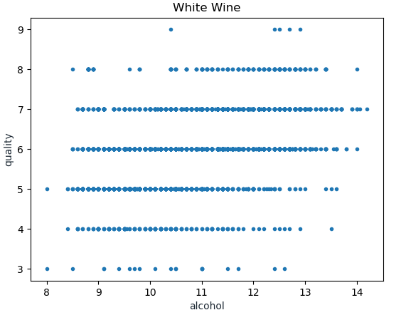
Positive correlation between alcohol and quality

Slide 3
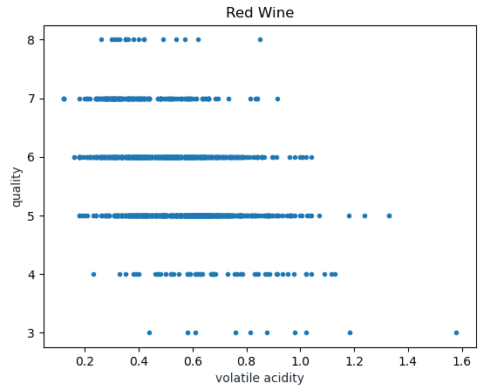
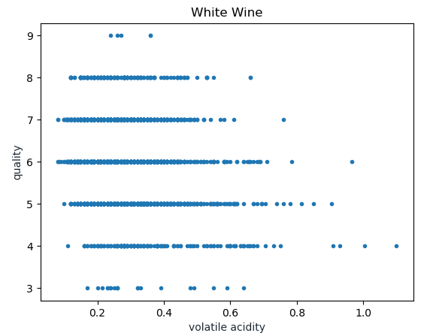
Negative correlation between volatile acidity and quality

Slide 4
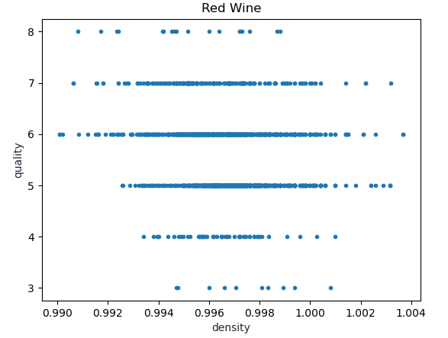
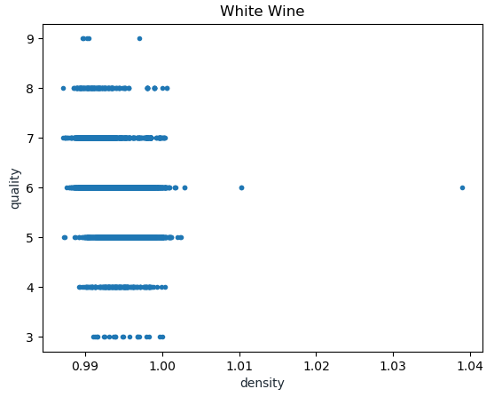
Negative correlation between density and quality, but only for red wine

Slide 5
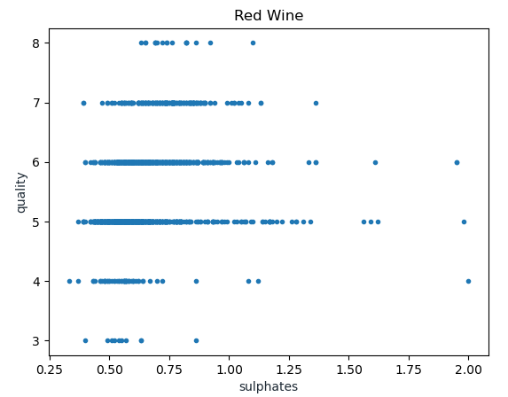
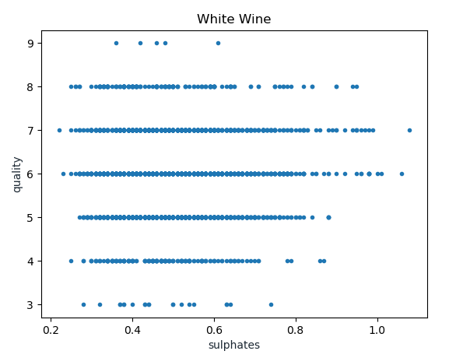
Positive correlation between sulphates and quality, but only for white wine

Slide 6
Planned Approach
Given the various correlations between the scatter plots, we will use some variables on red wines and different variables on white wines. In particular:
Red Wine – Alcohol Content, Volatile Acidity, and density
White Wine – Alcohol Content, Volatile Acidity, and sulphates
Since we have 4,500 data points for white wine and only 1,500 for red wine, we will likely use more powerful models on white wine – i.e., multivariate regression. We will also combine the guesses for different models, figuring that the average of two models will be more accurate than any model in particular – model crowd source machine learning

